Slide 1
JAVA PROJECT
MODERN JUKEBOX
PRESENTED BY
-M Venkata Kalyan

Slide 2
CONTENTS
INTRODUCTION TO EXISTING JUKEBOX
ADVANTAGES OF MODERN JUKEBOX
ENTITY RELATIONSHIP DIAGRAM
SCHEMA DIAGRAM
CLASS DIAGRAM
IMPLEMENTATION CLASSES
DAO CLASSES
MODEL CLASSES
OUTPUTS OF MMODERN JUKEBOX

Slide 3
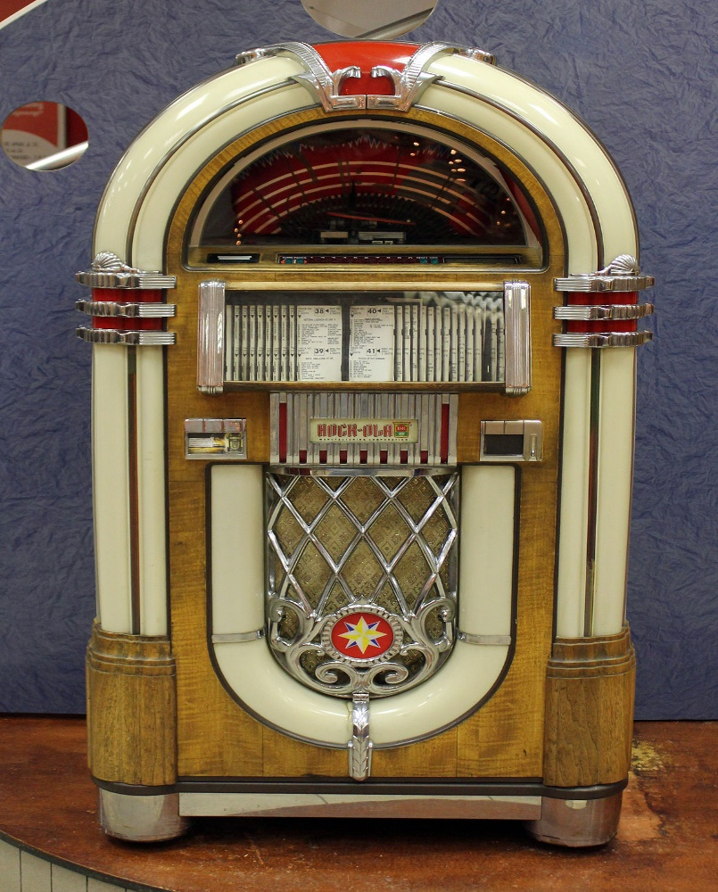
INTRODUCTION TO EXISTING JUKEBOX
EXISTING JUKEBOX IS USED TO PLAY SONGS AS USER CHOICE FOR UNLIMITED ENTERTAINMENT

Slide 4
ADVANTAGES OF MODERN JUKEBOX
USER CAN CREATE AN ACCOUNT
USER CAN CREATE MULTIPLE PLAYLIST
USER CAN PLAY SONGS
USER CAN PLAY PLAYLIST
USER CAN PLAY PODCASTS ALSO

Slide 5
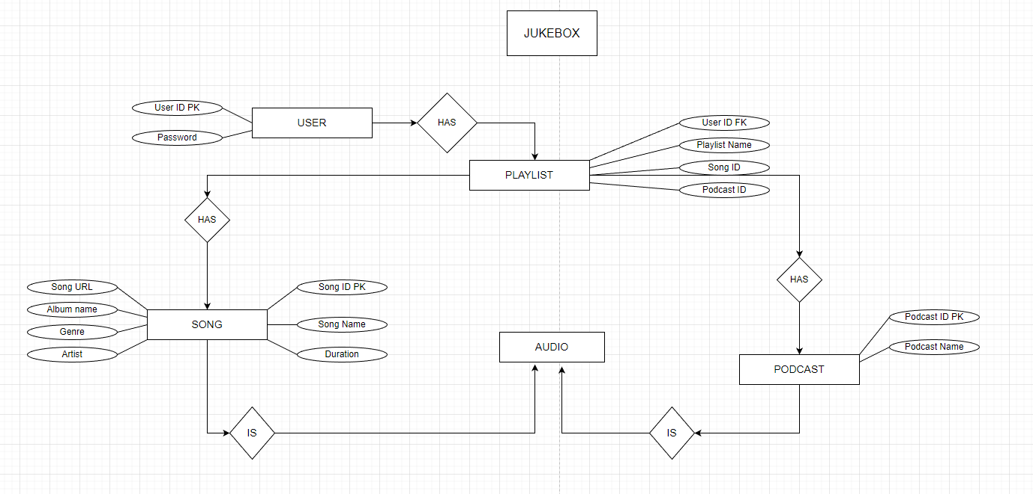
ENTITY RELATIONSHIP DIAGRAM

Slide 6
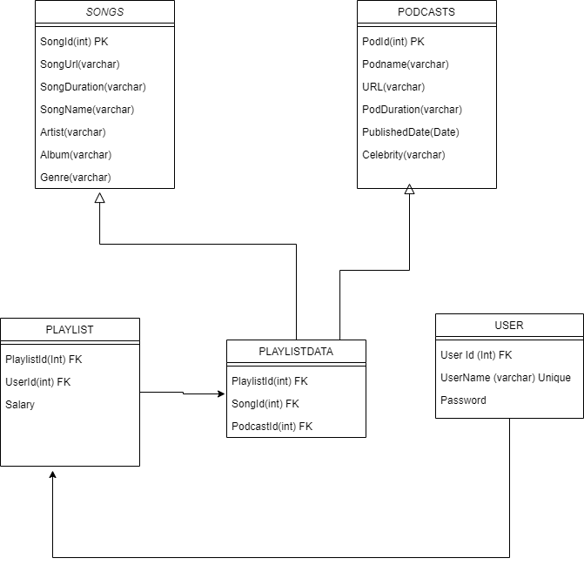
SCHEMA DIAGRAM

Slide 7
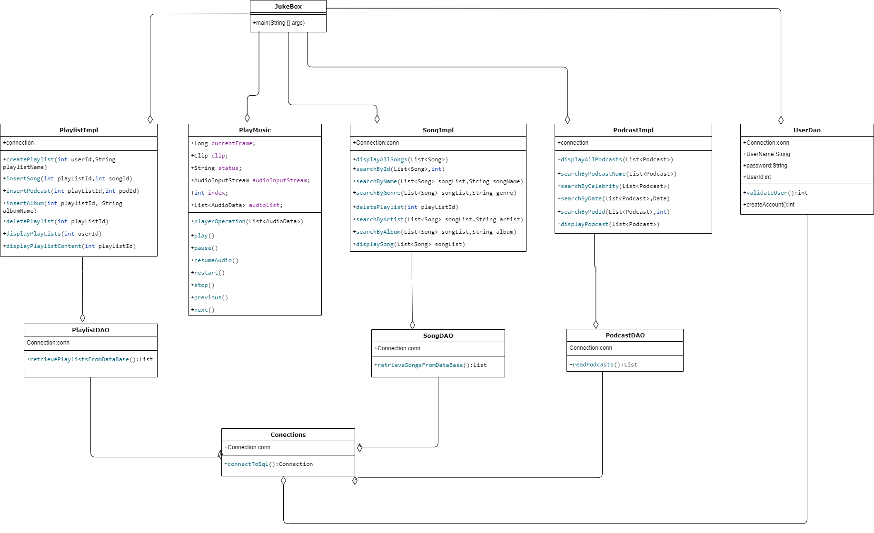
CLASS DIAGRAM

Slide 8
IMPLEMENTATION CLASSES
JUKEBOX
OPERAIONS LIKE SONGS,PLAYLISTS,PLAYAUDIO,PODCASTS
PLAYLISTIMPLEMENT
CREATE PLAYLIST, , DELETE PLAYLIST, INSERT A SONG, A PODCAST, AN ALBUM,SHOW PLAYLIST CONTENT
SONGIMPLEMENTATION
SEARCH A SONG BASED ON ID,NAME,ARTIST,ALBUM,GENRE, DISPLAY ALL SONGS
PODCASTIMPLEMENTATION
SEARCH A PODCAST BASED ON ID,NAME,CELEBRITY,DATE, DISPLAY ALL PODCASTS
PLAYMUSIC
PLAY,PAUSE,NEXT,PREVIOUS,RESUME,RESTART,EXIT;

Slide 9
DAO CLASSES
USERDAO
PODCASTDAO
SONGSDAO
PLAYLISTSDAO

Slide 10
MODEL CLASSES(POJO)
SONGS
PODCASTS
PLAYLISTS
AUDIO

Slide 11
THANK YOU

